Slide 2
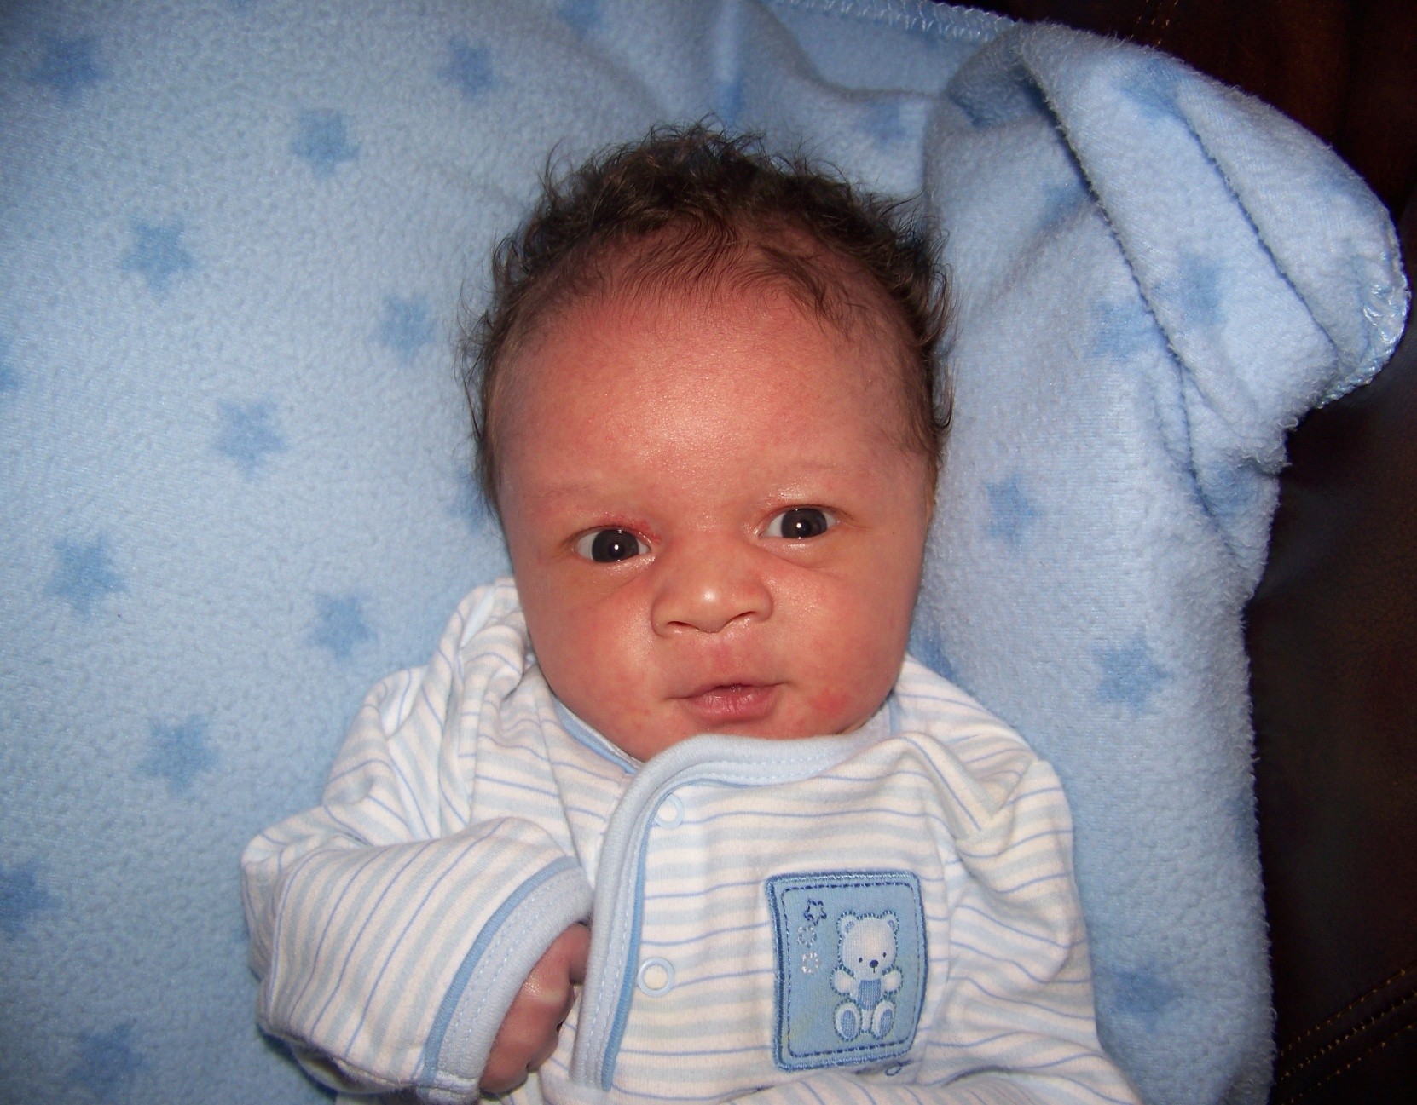

Slide 3
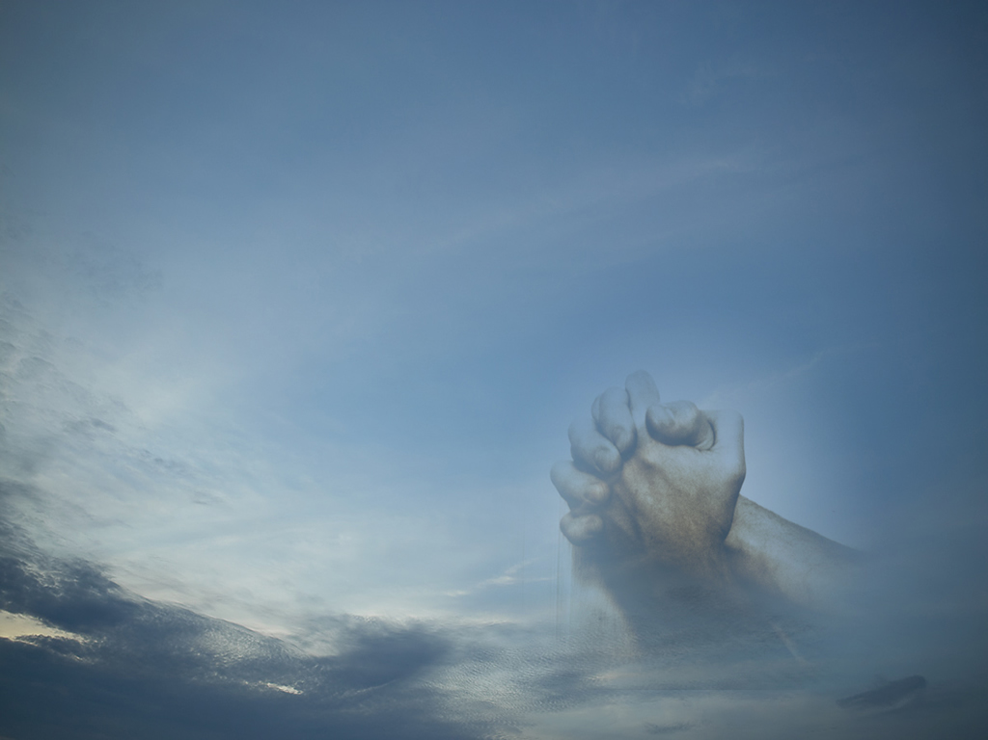
WORSHIP:
Life’s Greatest Moments
Ascribe to the LORD, O families of the peoples,
ascribe to the LORD glory and strength!
Ascribe to the LORD the glory due his name;
bring an offering, and come into his courts!
Worship the LORD in the splendor of holiness;
tremble before him, all the earth!
Psalm 96:7-9

Slide 4
WORSHIP: Life’s Greatest Moments
“WORSHIP” is…
…our words and actions telling God that He is worthy of our praise and adoration. He deserves our love and thanksgiving…It is action motivated from the heart, with the knowledge of who God is and what He has done for us…It is a mental act, a sense of awe and reverence in the presence of the DIVINE.
True Worship is based on reflective thought on what God has done, meditation on His greatness and goodness, and realization of His awesome presence.

Slide 5
WORSHIP: Life’s Greatest Moments
William Temple said…
“To worship is to quicken the conscience by the holiness of God, to feed the mind with the truth of God, to purge the imagination by the beauty of God, to open the heart to the love of God, to devote the will to the purpose of God.”

Slide 6
WORSHIP: Life’s Greatest Moments
WORSHIP…
is an acknowledgment of God’s help!
exercises praise for God’s power!
makes personal application!
prods us to rededicate & recommit!

Slide 7
WORSHIP: Life’s Greatest Moments
The “HEART” of WORSHIP…
“But the hour is coming, and is now here, when the true worshipers will worship the Father in spirit and truth, for the Father is seeking such people to worship him. God is spirit, and those who worship him must worship in spirit and truth.“ (John 4:23-24)

Slide 8
WORSHIP: Life’s Greatest Moments
4 Kinds of WORSHIP…
  Ignorant Worship (Acts 17:23)
  Vain Worship (Matt. 15:9)
  Will Worship (Col. 2:23)
  Spiritual Worship (John 4:23-24)

Slide 9
WORSHIP: Life’s Greatest Moments
Any “WORSHIP” activity has these elements…
  Authority (Rom. 4:3a)
  Audience (John 4:23)
  Attitude (Eph.5:19; Col.3:16)
  Action (1Cor.14:40; Heb.12:28)

Slide 10
WORSHIP: Life’s Greatest Moments
What is the “Heart”?…
Christianity is a “heart-felt” religion! (Jer.31:33-34; Romans 6:17-18)
Christianity is NOT a “heart-directed” religion!

Slide 11
WORSHIP: Life’s Greatest Moments
What is the “Heart”?…
The “heart” that is the object of God’s concern in worship…
…is that part of man called the “intellect”
…is that part of man called “emotions”
…is that part of man called the “will”
…is that faculty of man called the “conscience”

Slide 12
WORSHIP: Life’s Greatest Moments
What is the “Heart”?…
A “pure heart” is one that’s been cleansed to honor God!…
"Blessed are the pure in heart, for they shall see God.” (Matt.5:8).

